Slide 1
Chapter 4 – Unit Testing
Random -> worst strategy .. Will discuss these
What subset of all possible test cases has the highest probability of detecting the most errors?

Slide 2
Chapter 4 – Unit Testing
Module testing (or unit testing) => testing the individual subprograms, subroutines, classes, or procedures in a program.
Why:
1. focus initially on smaller units of the program.
2. easier for debugging
3. opportunity to test multiple modules simultaneously.
Compares: The function VS the module specification
The objective NOT to show that the module meets its specification,
but that the module contradicts the specification.

Slide 3
Module Example
Module Name: Bonus
Input: ArrayList<Employee>
Returns: updated ArrayList<Employee>
Rules: add $2,000 to the salary of all employees in the department or departments having the largest sales revenue.
BUT if an eligible employee’s current salary is $150,000 or more, or if the employee is a manager, the salary is to be increased by only $1,000.

Slide 4
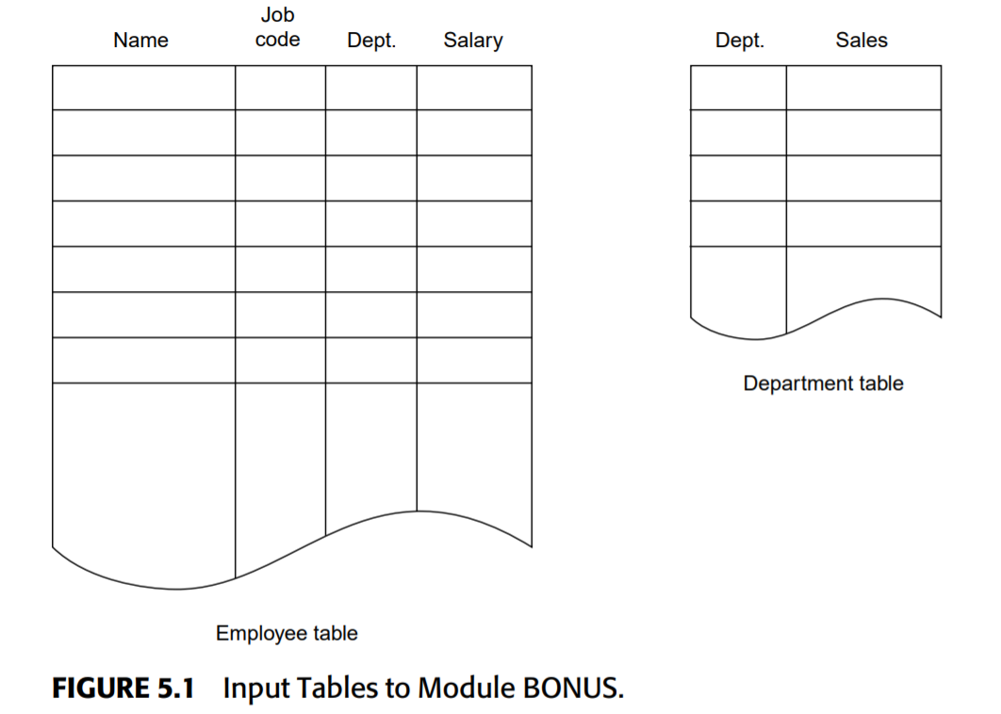

Slide 5
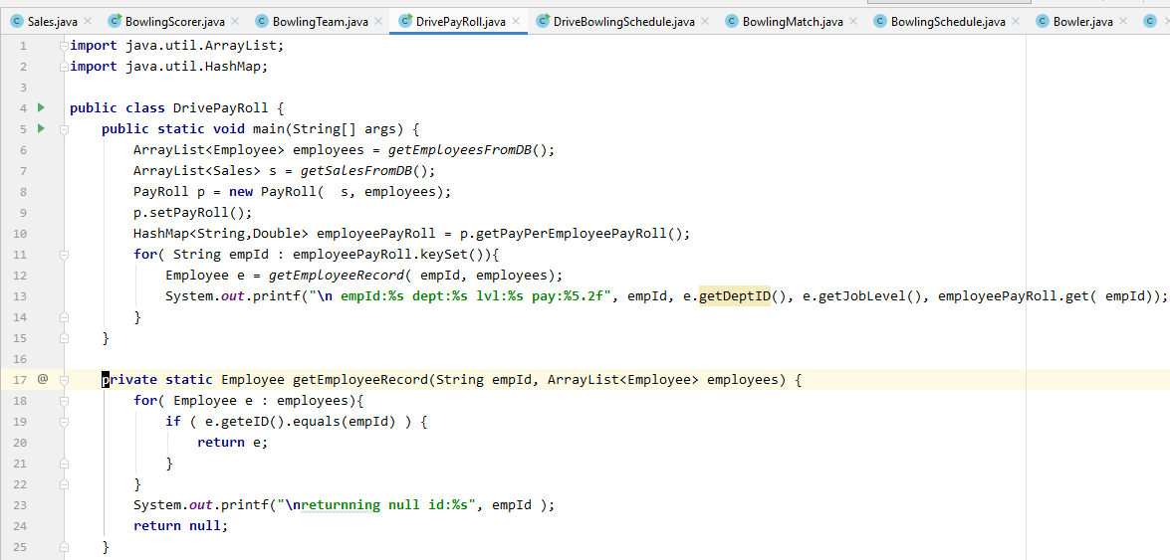
See Into to JUNIT.xls

Slide 6
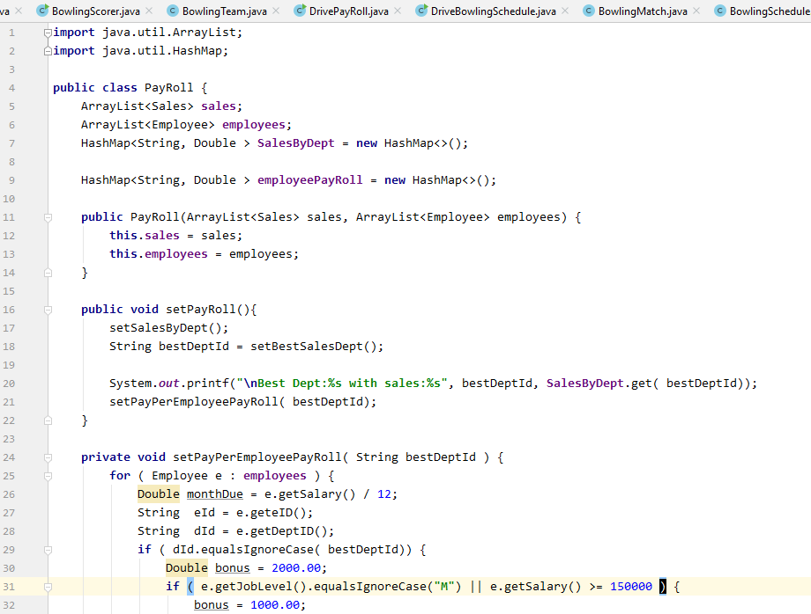
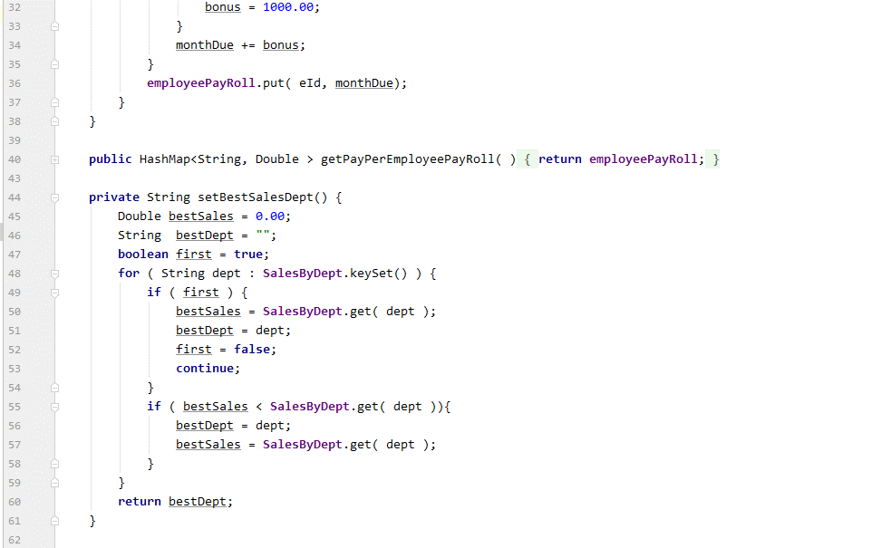
Here is interesting place for tests

Slide 7
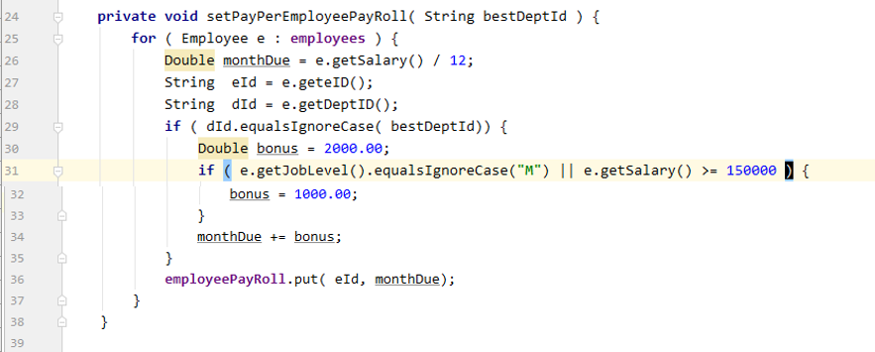
Where to test?
Does this occurs and doesn’t occur
What happens if 0 sales for all departments?
Or All departments had same sales?
Occurs with “M” and Occurs for < 15000
Works for NOT “M” and < 15000 Neither occurs
Item |  |  | Best Dept | Bonus
Employee | “M” | 150000 | “Y” | 1000
 | “M” | 149000 | “Y” | 1000
 | “E” | 150000 | “Y” | 1000
 | “E” | 149000 | “Y” | 2000
 | “M” | 149000 | “N” | 0
 | “E” | 149000 | “N” | 0
Work out basic coverage of these branches

Slide 8
What output expect for this coverage?
Item |  |  | Best Dept | Bonus | Compensation | Test Case
Employee | “M” | 150000 | “Y” | 1000 | 13,500 | 1
 | “M” | 149000 | “Y” | 1000 | 13,416.67 | 2
 | “E” | 150000 | “Y” | 1000 | 13,500 | 3
 | “E” | 149000 | “Y” | 2000 | 14,500 | 4
 | “M” | 149000 | “N” | 0 | 12,500 | 5
 | “E” | 149000 | “N” | 0 | 12,500 | 6

Slide 9
Other Input Boundaries
Item
Employees records ct | Employees 0 records | Employees 1 record | Employees > 1 record
Department Sales values | Department Sales 0 | Department sales a max | All depart sales the same | 2 department sales the same | Max sales negative

Slide 10
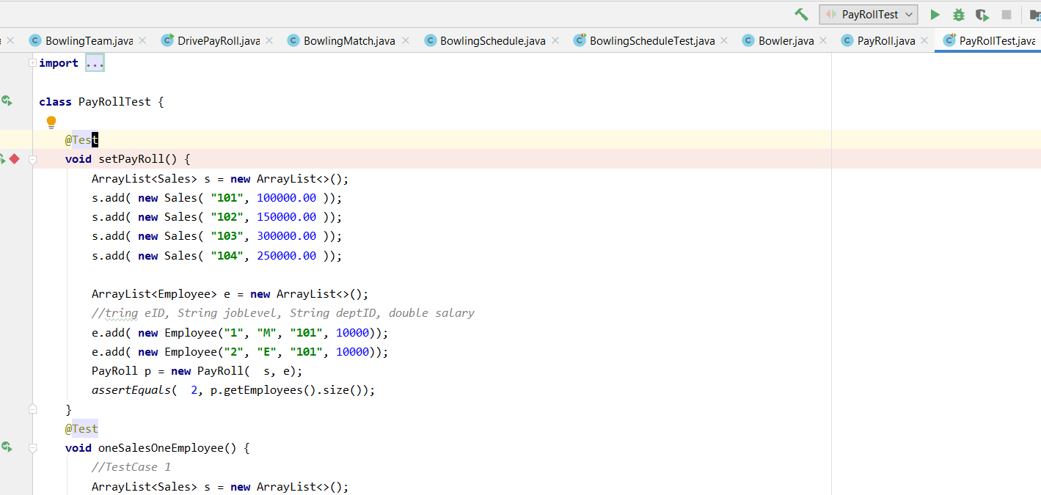

Slide 11
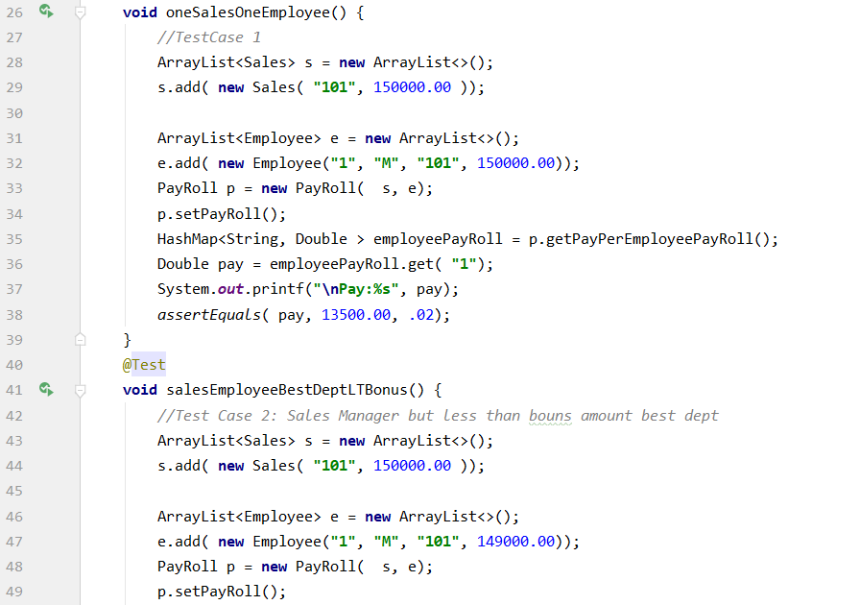
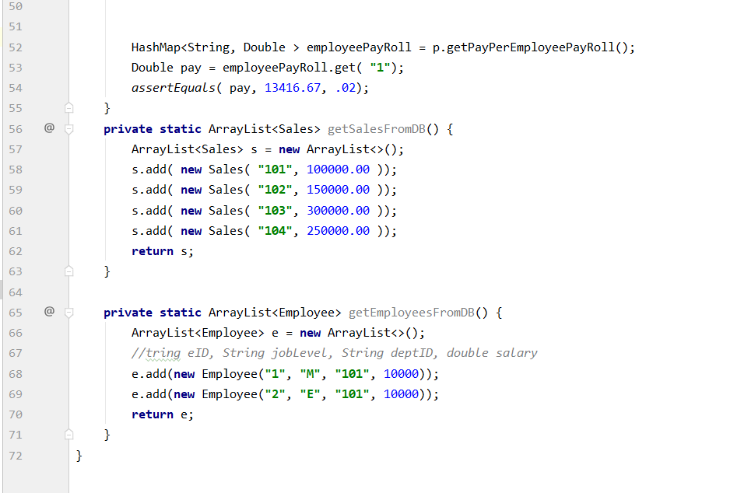

Slide 12
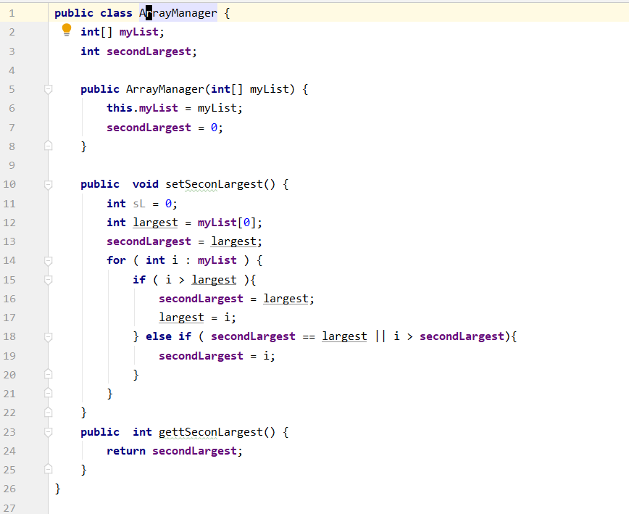
TC # | List | Return
1 | 1, 2, 3, | 2
2 | 1, 2, 3, 3 | 3
3 | {2} | 2
4 | {} | null
4.b | -3, -2 -1, 0 | -1
test where largest will be set and i will be > than it
Test where i <= largest and secondLargest != largest and i > secondLargest
TC #w | List | Return
5 | 1, 2 | 2
6 | 2,2 | 3
7 | 1, 3, 2 | 2
8 | 8, 7, 6, 4 | 7
Test 8 where i is never > largest or secondLargest
Test where i <= largest and secondLargest = largest

Slide 13
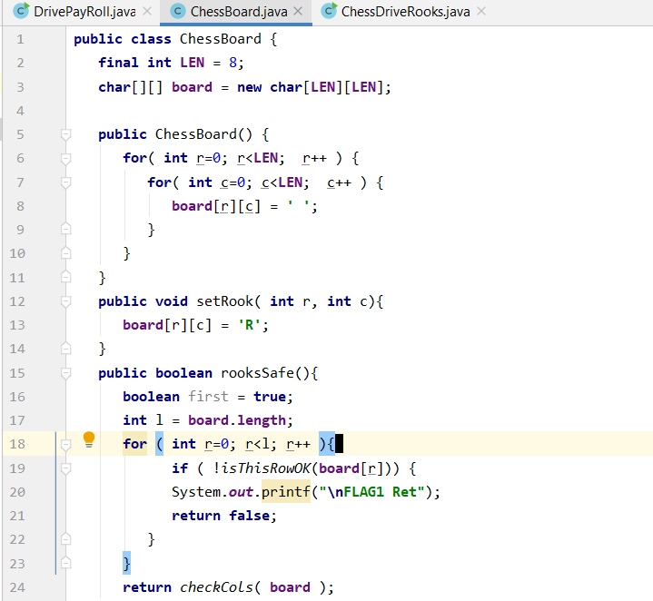

Slide 14
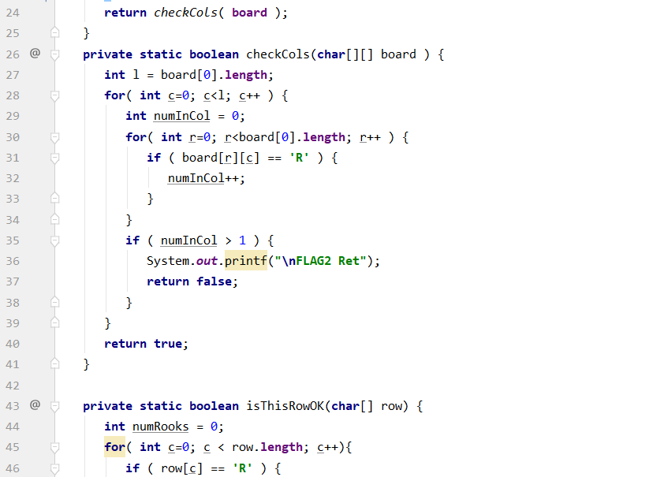
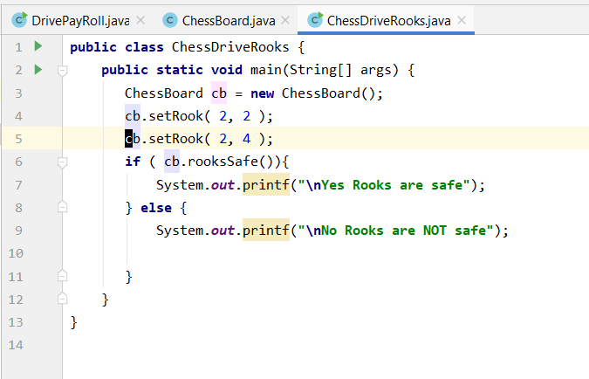
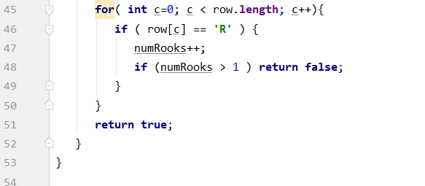

Slide 15
